Slide 1




MICRO CREDIT DEFAULTER MODEL
Submitted by:
Charitha Lanka

Slide 2

AGENDA
Overview.
Problem Statement.
What is Micro Credit?
Importance of Micro Credit Defaulter Model.
Exploratory data analysis.
Visualizations.
Analysis.
Data cleaning steps.
Data Balancing.
Model Building.
ROC-AUC Curve.
Saving the model and predictions from saved best model.
Conclusion.

Slide 3

OVERVIEW
In this particular presentation we will be looking on:
•How to analyze the dataset of Micro Credit Defaulters.
•What are the EDA steps in cleaning the dataset.
•Overall analysis on the problem.
•Model building from the cleaned dataset.
•Predicting defaulters for saved model.

Slide 4
PROBLEM STATEMENT
A Microfinance Institution (MFI) is an organization that offers financial services to low income populations. Many microfinance institutions (MFI), experts and donors are supporting the idea of using mobile financial services (MFS) which they feel are more convenient and efficient, and cost saving, than the traditional high-touch model used since long for the purpose of delivering microfinance services. Though, the MFI industry is primarily focusing on low income families and are very useful in such areas, the implementation of MFS has been uneven with both significant challenges and successes. Today, microfinance is widely accepted as a poverty-reduction tool, representing $70 billion in outstanding loans and a global outreach of 200 million clients. We are working with one such client that is in Telecom Industry. They have launched various products and have developed its business and organization based on the budget operator model, offering better products at Lower Prices to all value conscious customers through a strategy of disruptive innovation that focuses on the subscriber.

Slide 5
A
Microcredit is an extremely small loan given to those who lack a steady source of income, collateral.
Before we start learning, let's try to answer this question:
WHAT IS MICRO CREDIT?
B
It is used as a way to obtain a loan, acting as a protection against potential loss for the lender should the borrower default in his payments., or any credit history.

Slide 6

IMPORTANCE OF MICRO CREDIT DEFAULTERS MODEL
Microfinance in India has seen incredible growth in the last two decades in terms of the number of Microfinance customers and institutions offering Microfinance. The model will be a good way for the management to understand whether the customer will be paying back the loaned amount within 5 days of insurance of loan. The relationship between predicting defaulter and the economy is an important motivating factor for predicting micro credit defaulter model.

Slide 7
EXPLORATORY DATA ANALYSIS
Imported necessary Libraries and loaded the dataset.
Statistical Analysis done like Shape, info, nunique, value_counts.
Dropped columns with more than 90% of Zero values.
Dropped columns withall unique or 1 unique value.
Feature extraction done in pdate and extracted pday, pmonth and pyear.
Converted few columns with negative values to positive values.
Checked Correlation between Variables and Feature
Outliers removed, Encoded categorical columns.
Skewness removed, removed columns with Multicollinearity issue.
Using Min-Max Scaler, normalized the data.
No Null values in the dataset.

Slide 8

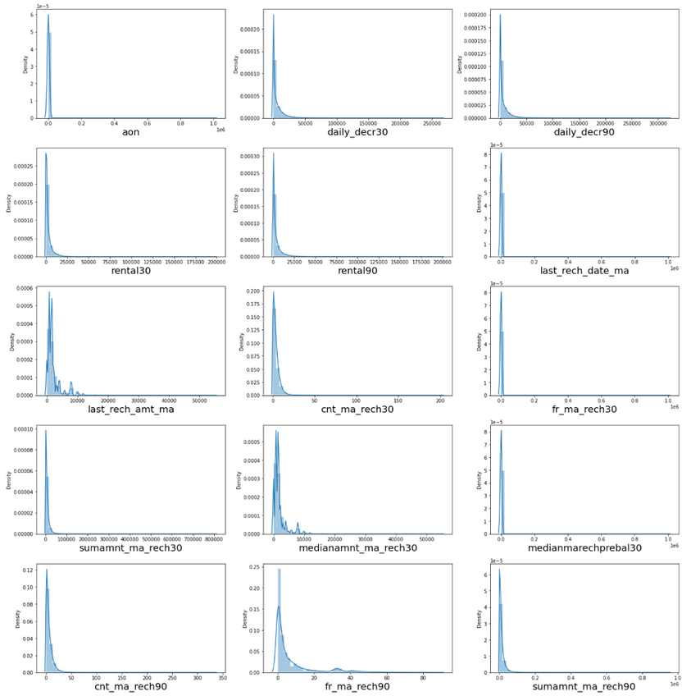
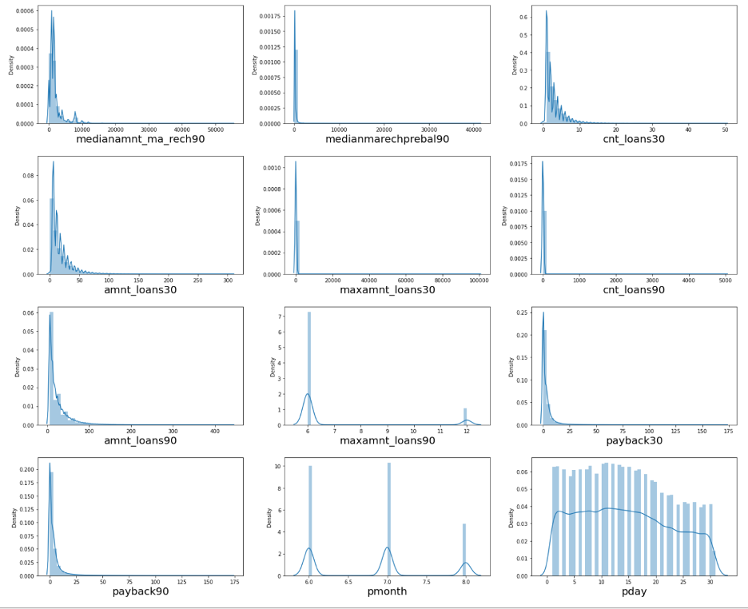
VISUALIZATION

Slide 9

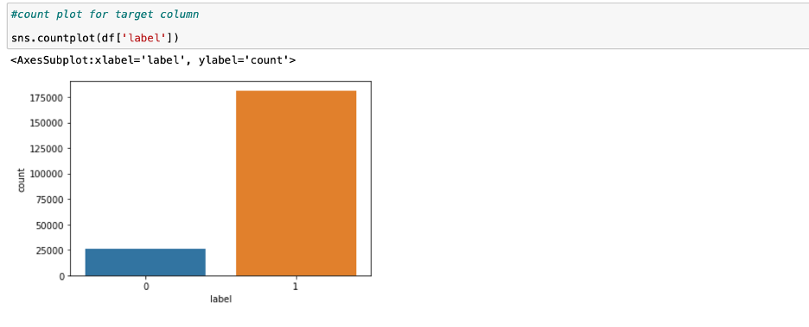
OBSERVATIONS:
Almost all columns are right skewed.
We have symmetrical distribution for the pday and pmonth columns.
Count plot of Target column

Slide 10
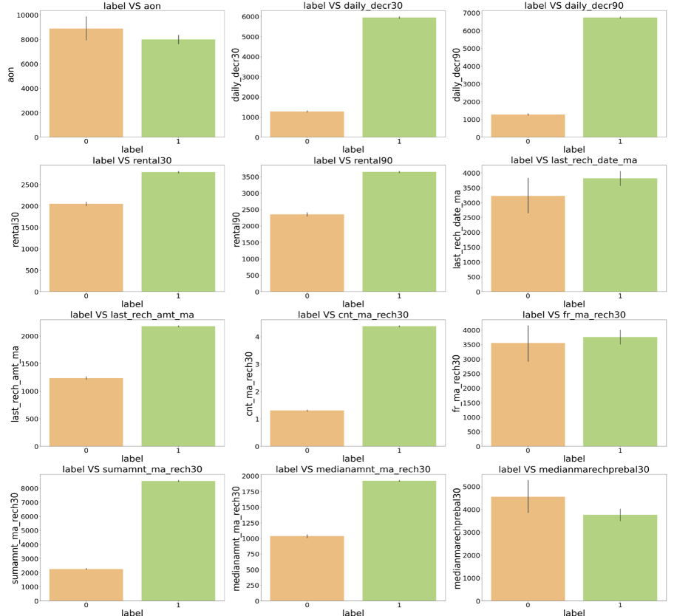
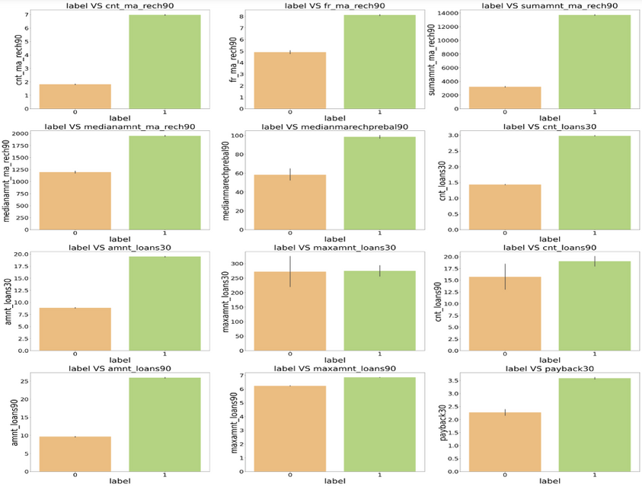
VISUALIZATION

Slide 11
OBSERVATIONS:
Customers with high value of Age on cellular network in days(aon) are maximum defaulters (who have not paid there loan amount 0).
Customers with high value of Daily amount spent from main account, averaged over last 30 days
Customers with high value of Daily amount spent from main account, averaged over last 90 days
Customers with high value of Average main account balance over last 30 days(rental30) are maximum Non-defaulters
Customers with high value of Average main account balance over last 90 days(rental90) are maximum Non-defaulters
Customers with high Number of days till last recharge of main account are maximum Non-defaulters.
Customers with high value of Amount of last recharge of main account.
Customers with high value of Number of times main account got recharged in last are maximum Non-defaulters
Customers with high value of Frequency of main account recharged in last 30 are maximum Non-defaulters and also the count is high for defaulters comparatively Non-defaulters are more in number.
Customers with high value of Total amount of recharge in main account over last 30 days are maximum Non-defaulters
Customers with high value of Median of amount of recharges done in main account over last 30 days at user level are maximum Non-defaulters.
Customers with high value of Median of main account balance just before recharge in last 30 days at user level are maximum defaulters.
Customers with high value of Number of times main account got recharged in last 90 are maximum Non-defaulters
Customers with high value of Frequency of main account recharged in last 90 are maximum Non-defaulters
Customers with high value of Total amount of recharge in main account over last are maximum Non-defaulters .
Customers with high value of Median of amount of recharges done in main account over last 90 days at user level are maximum Non-defaulters.
Customers with high value of Median of main account balance just before recharge in last 90 days at user level are maximum Non-defaulters
Customers with high value of Number of loans taken by user in last 30 days are maximum Non-defaulters.
Customers with high value of Total amount of loans taken by user in last 30 days(amnt_loans30) are maximum Non-defaulters
Customers with high value of maximum amount of loan taken by the user in last

Slide 12


ANALYSIS
I have used various Analytical tools in this Notebook.
I have used dist plot for each univariate numerical features and it says that there is skewness in almost all columns.
I have used Bar-plots to find the relationship between columns and Target.
I found that in maximum features the count of non-defaulters is high compared to defaulters so the risk is less comparatively.

Slide 13
DATA CLEANING STEPS
In my datasets I did not found null values, but I found outliers and skewness.
To remove outliers I have used percentile method. And to remove skewness I have used yeo-johnson method.
To replace the negative values to positive values I have used abs.
Use of Pearson’s correlation coefficient to check the correlation between dependent and independent features.
Also I have used Normalization. Then followed by model building with all Classification algorithms.

Slide 14
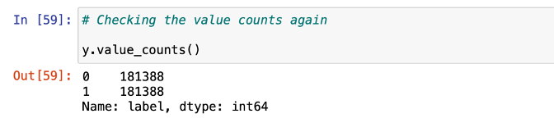
DATA BALANCING
The target label is imbalanced. I have used SMOTE Technique to balance the data.

Slide 15
MODEL BUILDING
Since label was my target and it was a classification column with 0-defaulter and 1-Non-defaulter, so this particular problem was Classification problem. And I have used all Classification algorithms to build my model. By looking into the difference of accuracy score and cross validation score I found RandomForestClassifier as a best model with least difference. Also to get the best model we have to run through multiple models and to avoid the confusion of overfitting we have go through cross validation. Below are the list of classification algorithms I have used in my project.
Decision Tree Model
Random Forest Classifier
KNN Classifier
XGB Classifier

Slide 16
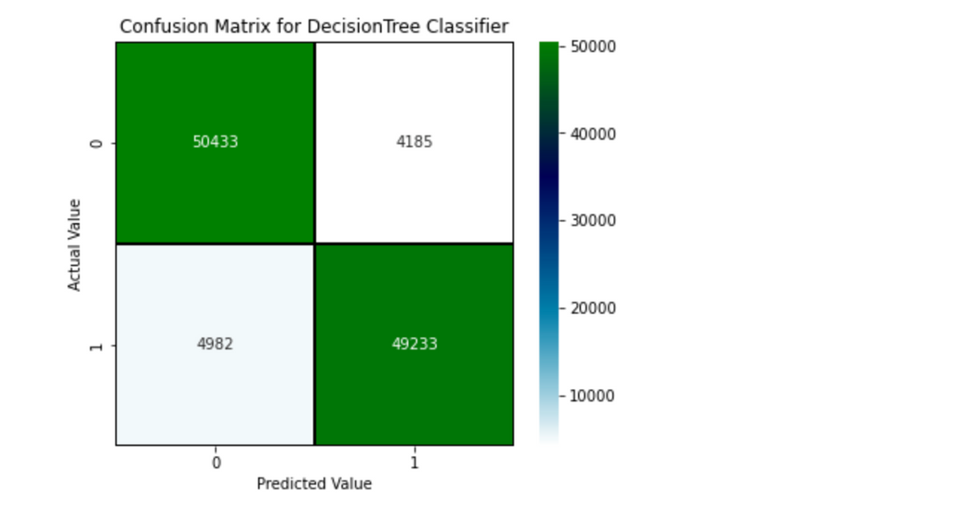
DECISION TREE CLASSIFIER MODEL
I found the best random state which yields the best score and then fit the model. Accuracy score for Decision Tree Model was 91.57%. I have tuned with different parameters and the score has decreased to 80.86%. The CV Score of Decision tree model without tuned parameters are 91.14%. The Confusion Matrix of actual and predicted values using Decision Tree model is:

Slide 17
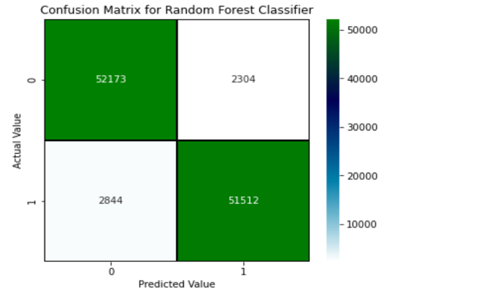
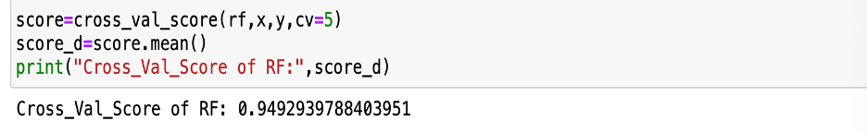
RANDOM FOREST CLASSIFIER MODEL
II first found the best random state and fit the model. I got a score of 95.26 % and a CV Score of 94.92%. Hence, I selected the random forest as the best model and saved the model. While performing the fitting of the final model, my score was improved, and it became 95.59%.
CV Score:

Slide 18
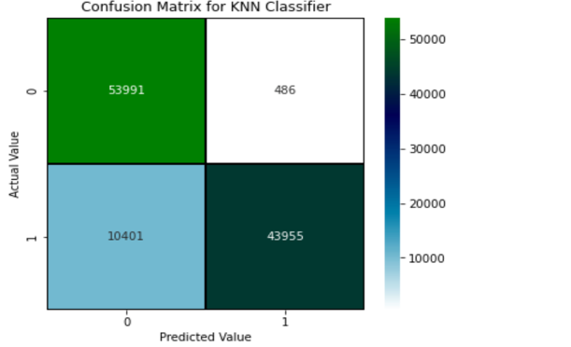
KNN CLASSIFIER MODEL
For KNN Model, the Accuracy score is 89.99%. The CV Score for the KNN Model is 90.40%. Confusion matrix of the KNN Model is:

Slide 19
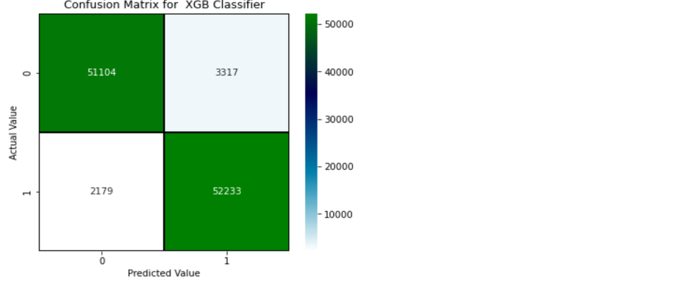
XGB CLASSIFIER MODEL
The Accuracy score of XGB Model is 94.95% and CV Score of 93.63%.

Slide 20

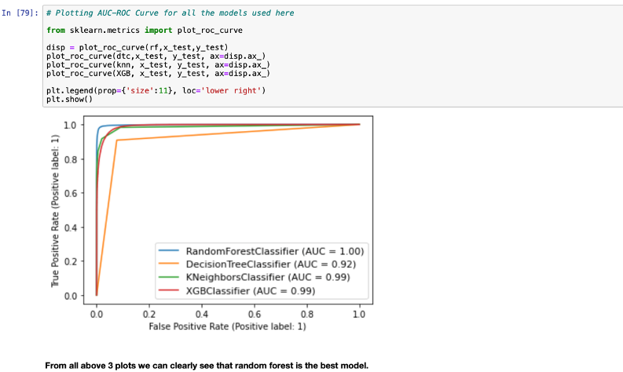
AUC-ROC CURVE
AUC_ROC Curve of all models shows random forest as Best Model

Slide 21

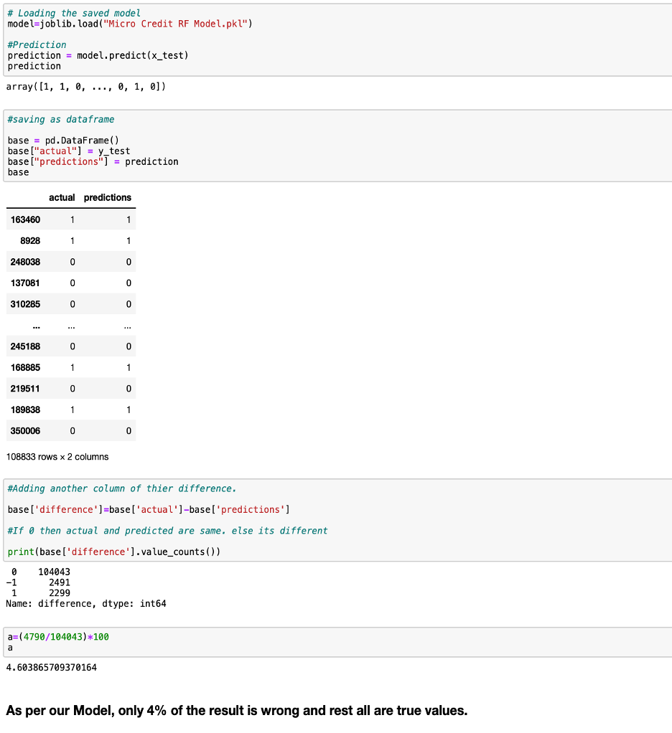
SAVING THE MODEL AND PREDICTIONS

Slide 22















THANK YOU

